Slide 1
GO profiling and optimization
Shuyan Li
CS263

Slide 2
In the last lecture: Why profiling
To improve performance, track performance regressions
-find out where time is being spent
To characterize program behavior
-runtime
-program test
To capture specific or unusual behavior

Slide 3
In my presentation
Where shall we start profiling?
What shall we profiling?
How do we do the profiling?

Slide 4
Introduction: tools we can use
1: pprof
-terminal (command line)
-multiple flag(-memflag, -cpuflag), diagrams, programmer friendly
-benchmark
-different ways to check performance
-controllable
2: stackImpect
-third-party platform
-show the results dynamically on the dashboard
-one can see the in-time performance
-un-controllable

Slide 5
1. Where shall we start?
1) add the CPU flag and memory flag in code and use pprof in terminal to get the performance of the program:
(pprof) top10
16160ms of 23130ms total (69.87%)
Dropped 97 nodes (cum <= 115.65ms)
Showing top 10 nodes out of 74 (cum >= 1540ms)
flat flat% sum% cum cum%. //cumulative
2550ms 11.02% 11.02% 2760ms 11.93% runtime.mapaccess1_fast64
2360ms 10.20% 21.23% 5590ms 24.17% runtime.scanobject
1910ms 8.26% 29.49% 4530ms 19.58% runtime.mapassign
1670ms 7.22% 36.71% 1710ms 7.39% runtime.greyobject
1660ms 7.18% 43.88% 12680ms 54.82% main.FindLoops
1580ms 6.83% 50.71% 1580ms 6.83% runtime.heapBitsForObject
1580ms 6.83% 57.54% 4090ms 17.68% runtime.mallocgc
1070ms 4.63% 62.17% 2860ms 12.36% main.DFS
960ms 4.15% 66.32% 960ms 4.15% runtime.memmove
820ms 3.55% 69.87% 1540ms 6.66% runtime.makemap

Slide 6
1. Where shall we start?
2) getting the svg diagram(shown in next slice)

Slide 7
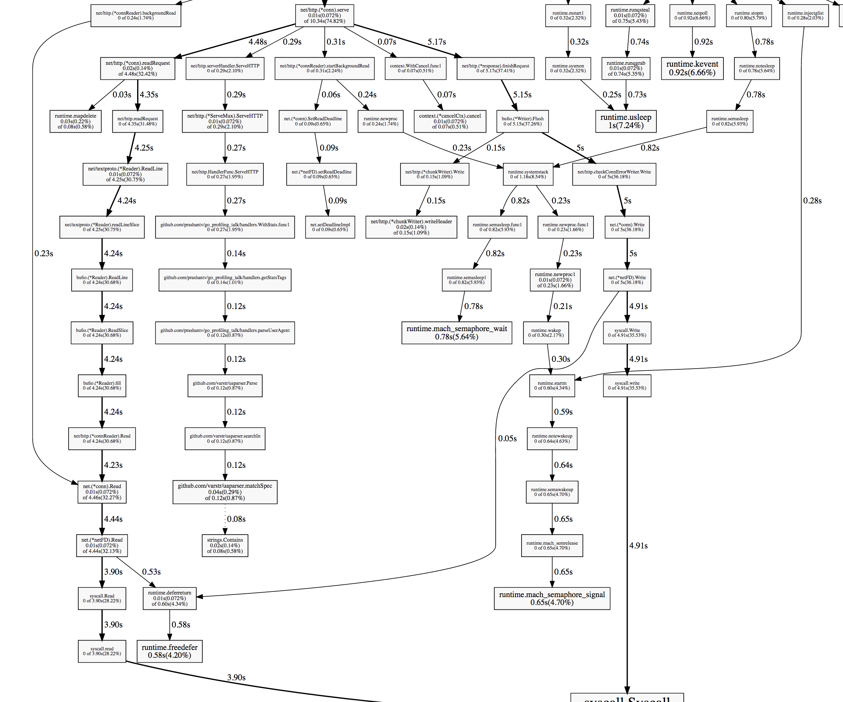

Slide 8
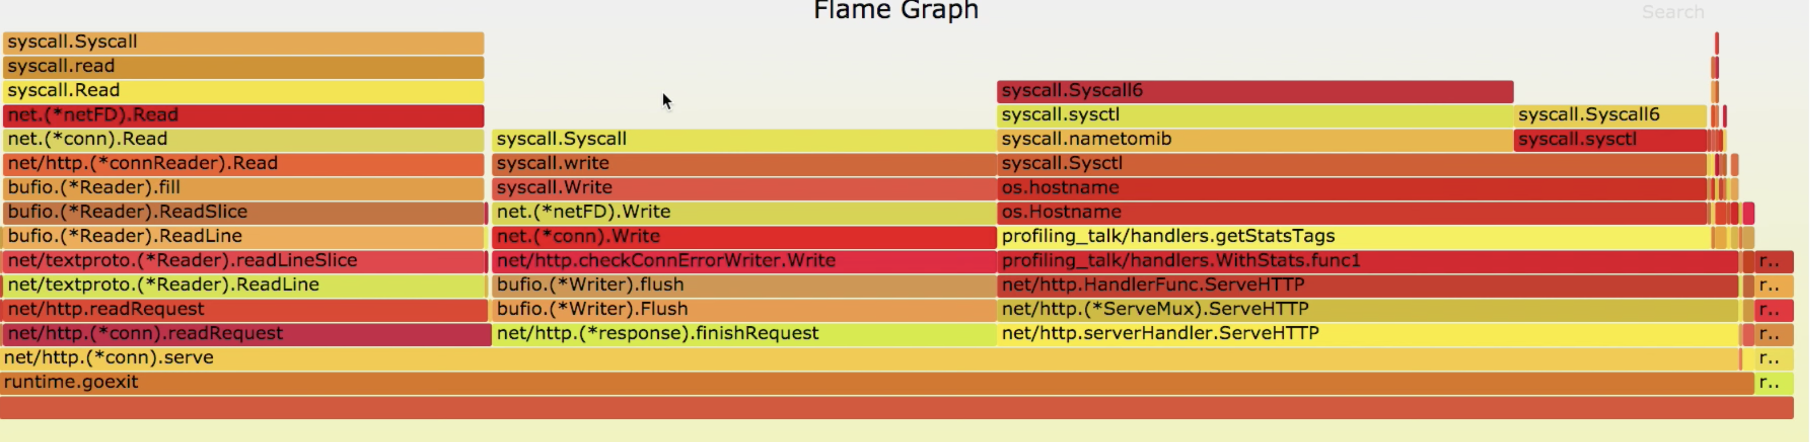
Flame Graph

Slide 9
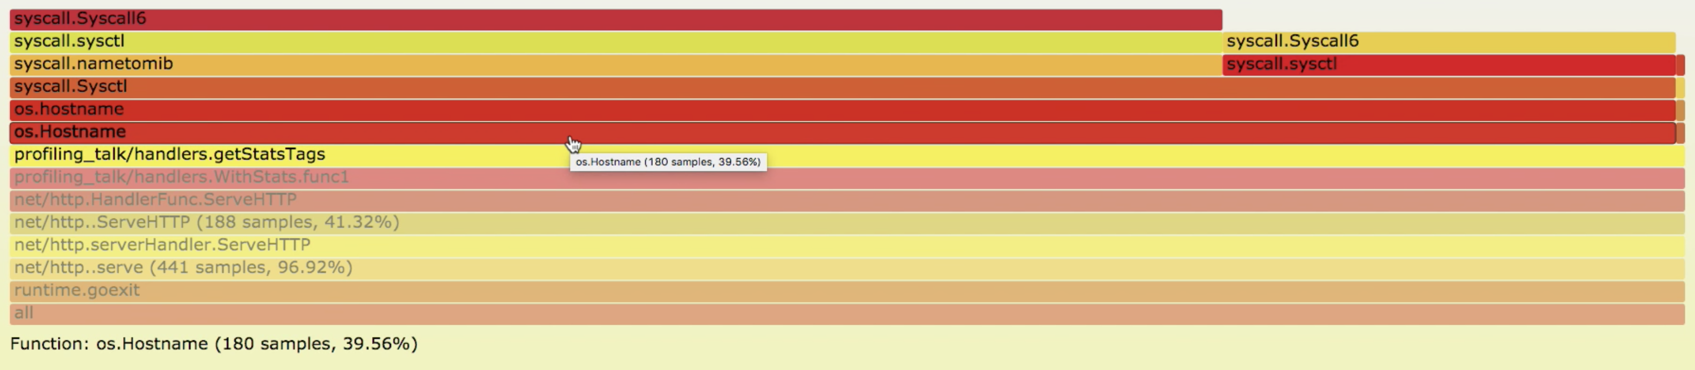
1. Where shall we start?
3) Based on the diagrams, find out the hot program and the place to start our profiling:

Slide 10
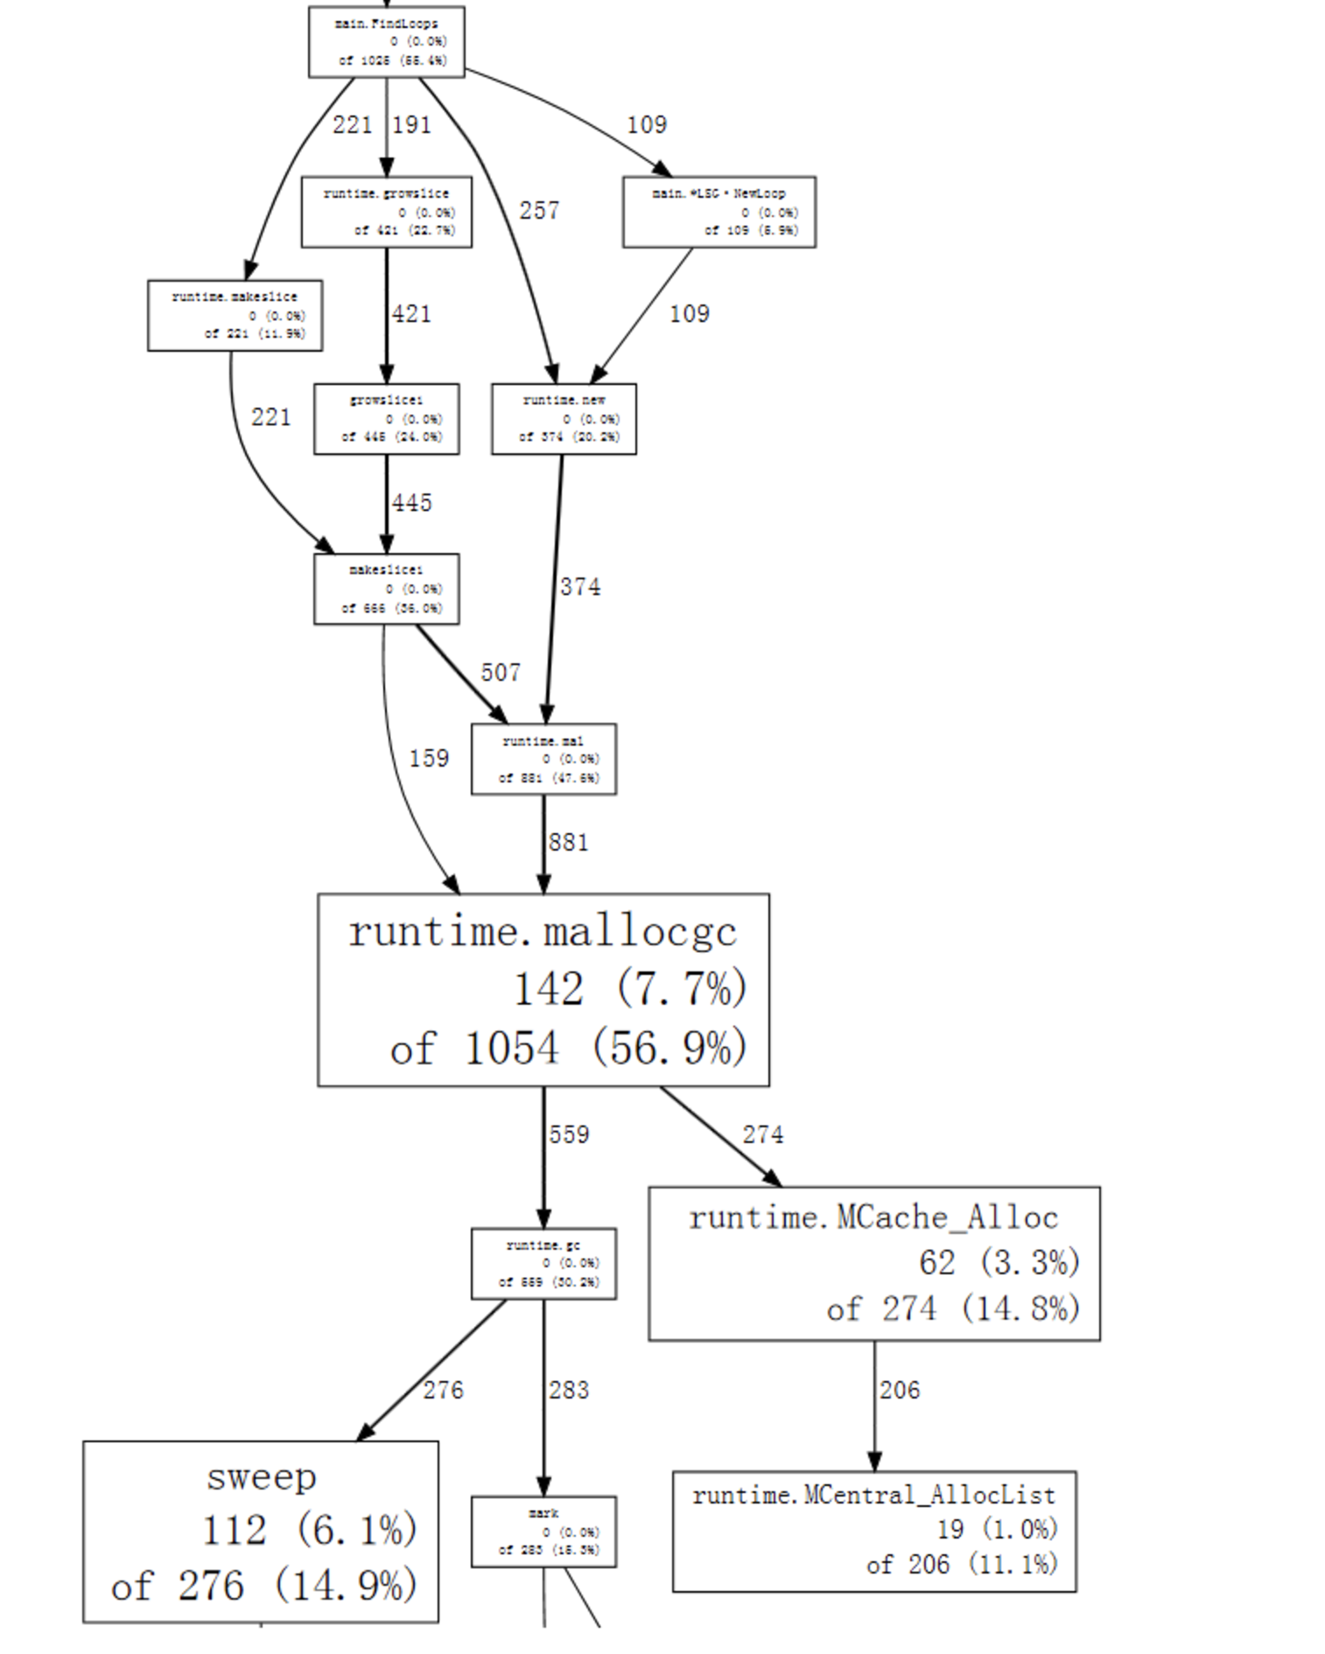

Slide 11
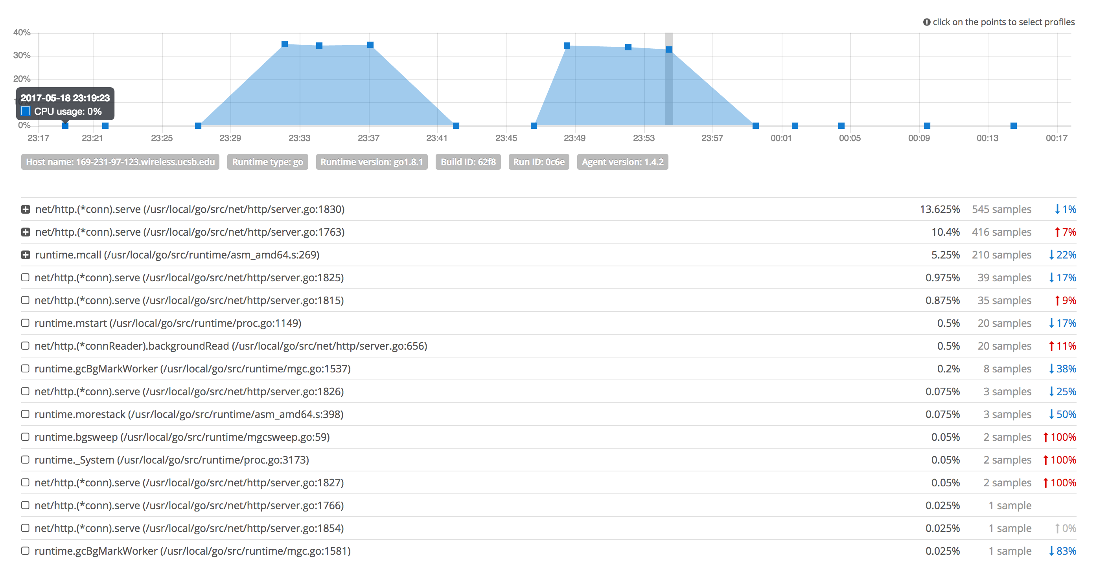

Slide 12
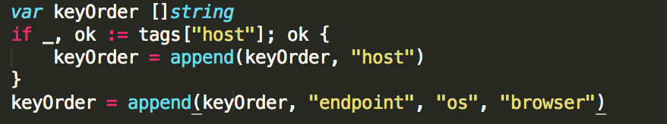
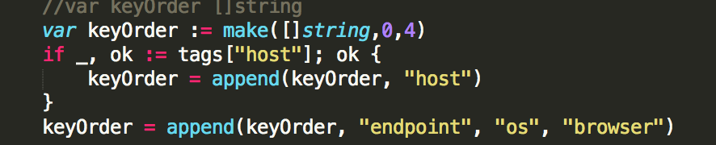
2: What and how do we profile?
A) intermediate objects: one simple example

Slide 13
Result after
169-231-98-53:stats shuyanli$ go test -bench . -benchmem -cpuprofile prof.cpu
BenchmarkAddTagsToName-8 500000 1214 ns/op 220 B/op
17 allocs/op
and now we have:
ShuyanmatoMacBook-Pro:stats shuyanli$ go test -bench . -benchmem -cpuprofile prof.cpu
BenchmarkAddTagsToName-8 300000. 580 ns/op 144 B/o
10 allocs/op

Slide 14
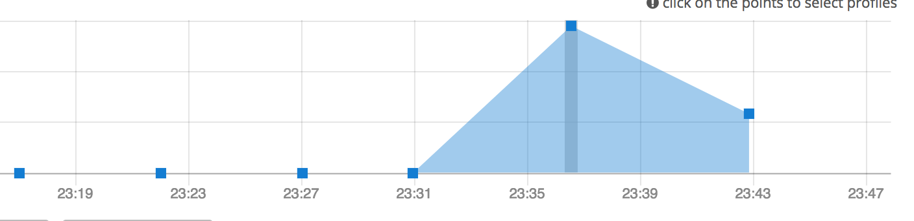
CPU performace after profiling

Slide 15
2: What and how do we profile?
B) cache

Slide 16
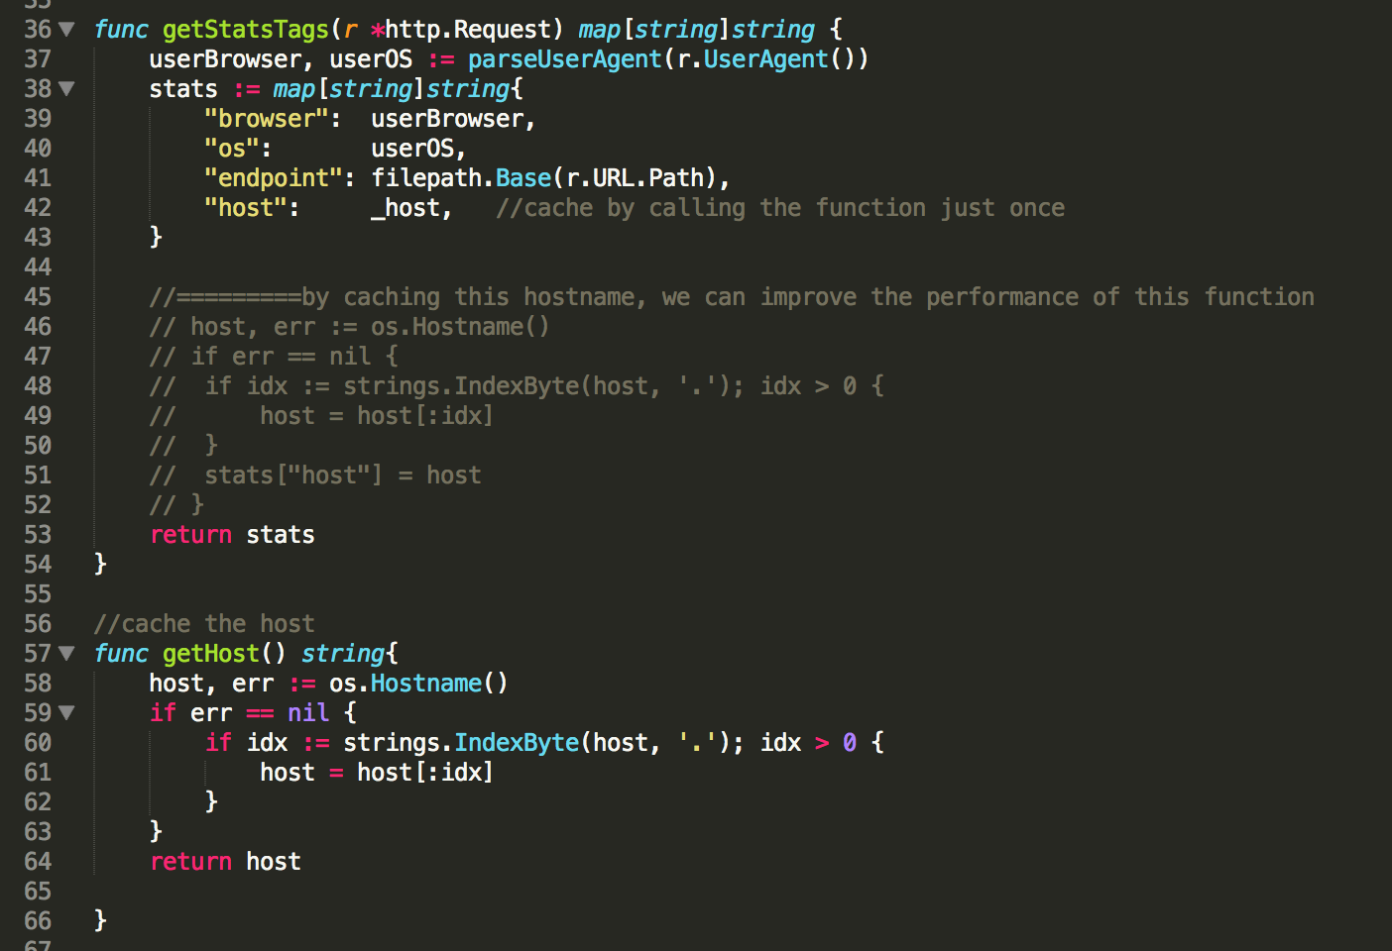

Slide 17
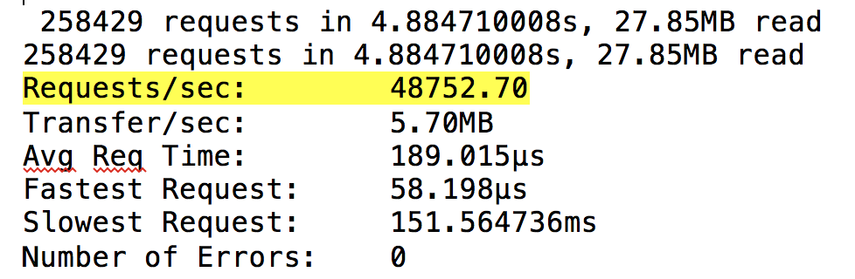
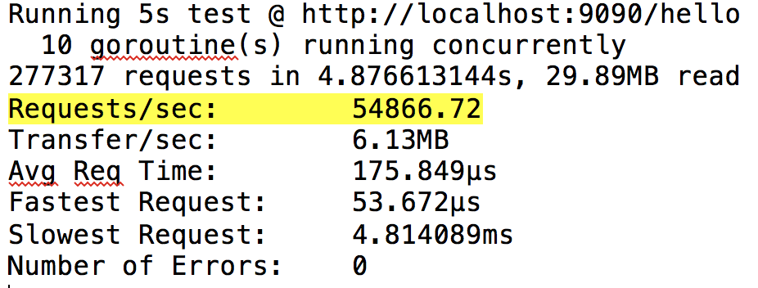
2: What and how do we profile?
B) Cache: improvement

Slide 18
2: What and how do we profile?
C) data structure
Sometimes even if the algorithms are the same, which means the big O of the function is the same, the performance of this function varies a lot due to different data structures that function use. For example, using either map or an array(slice in go) to store some data. However, in some cases, using an array instead of map, if possible, can reduce time the functions consume.
Before: (u means time spent in user mode)
# of loops: 76000 (including 1 artificial root node)
26.02u 0.24s 19.83r 1288896512kB
After
# of loops: 76000 (including 1 artificial root node)
17.70u 0.19s 12.34r 1227948032kB

Slide 19
2: What and how do we profile?
D) built-in library or packages
Sometimes when we call the library functions, or some functions from packages, the performance is not good, even if the library is a well-performance, well-designed library. The reason is that most of the library are general. For some specific case, however, we might want to implement our own functions (or override the library functions) so that it can run better than the original library functions. They may not be widely-use, but they can be very fast.

Slide 20
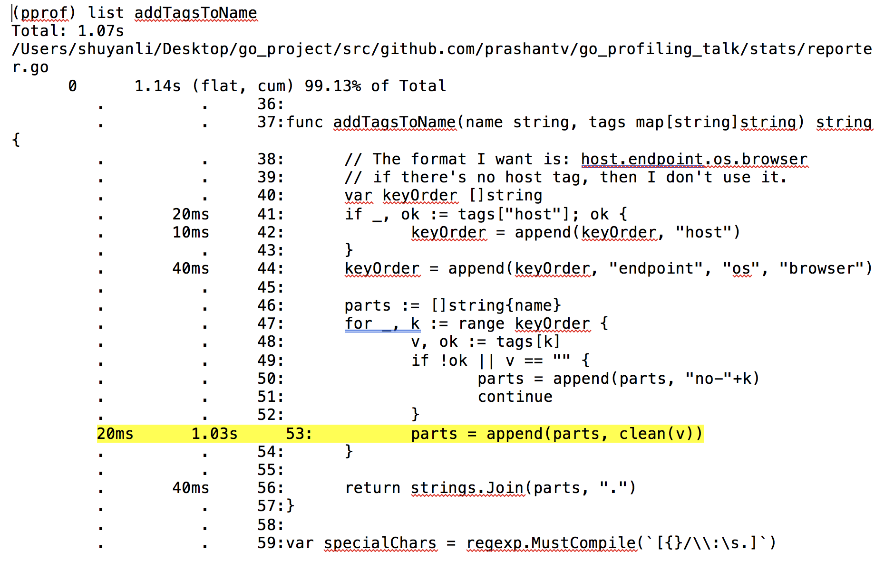

Slide 21
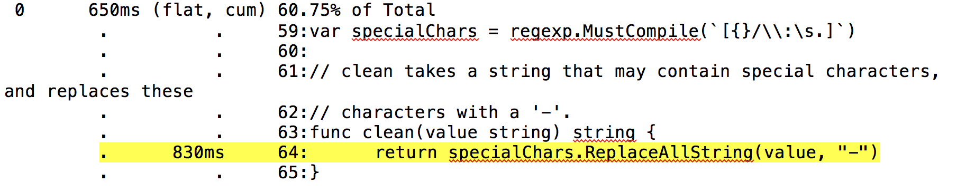
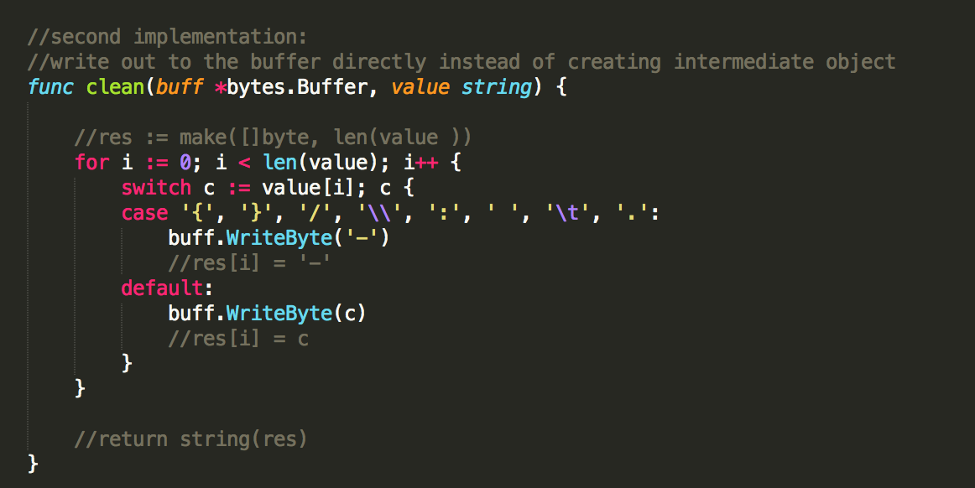
Notes:
this function just read each char, if they are specialChars, I replace it with “-”, pretty standard O(n) algorithm

Slide 22
Result:
169-231-98-53:stats shuyanli$ go test -bench . -benchmem -cpuprofile prof.cpu
BenchmarkAddTagsToName-8 500000 1214 ns/op 220 B/op 17 allocs/op
Compare to the previous naïve algorithm:
169-231-98-53:stats shuyanli$ go test -bench . -benchmem -cpuprofile prof.cpu
BenchmarkAddTagsToName-8 500000 2524 ns/op 528 B/op 19 allocs/op

Slide 23
2: What and how do we profile?
E) avoid allocation
An allocation means a possible GC. This doesn’t mean GC is slow. GC is actually pretty fast. It’s just because every time we allocate, the run time has to do extra work to find some space, so allocations are not free. As a result, we want to minimize the allocation number. Check the path (hot path) where the number of allocation is high. Using the way introduced above to minimize the allocation number.

Slide 25
Brief idea of where allocation come from
we first create a slice called KeyOrder, which in this case is an empty slice that doesn’t have any capacity and length. We then use append to add the host string to this slice. Now there is a re-allocation since we allocate a new slice, copy over all the elements (actually there is nothing we can copy form keyOrder) to the keyOrder. Then we call the append again to append the slice. In other words, we did 2 more allocation, which was a waste of time and space.

Slide 26

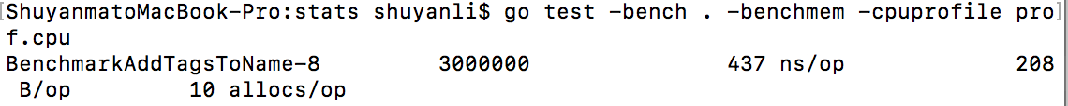

Small steps every day

Slide 27
stackImpect

Slide 28
Tear program apart
Writing a benchmark can help figuring out the details of the program without keep running the program repeatedly. More important, sometime allocation number of one function is high due to the functions it calls. Sometimes these functions hide very deep. Using a stackImpect cannot help to find them out but using a benchmark can.
What’s more, disassemble the function can also help. For example:

Slide 29
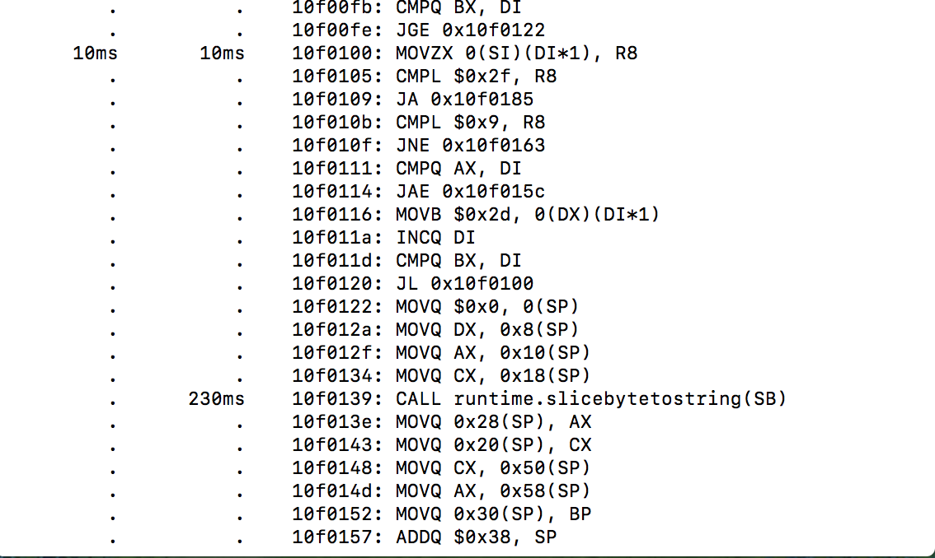
Tear program apart

Slide 30
Thank you
Q&A

